Slide 1
ANVU (Australian National Vulvar Cancer Trial) A Phase II Randomised Clinical Trial of Ultrasound Groin Monitoring versus Groin Lymph Node Dissection to De-Escalate the Extent of Surgery in Vulvar Cancer
STUDY SPONSOR: The University of Queensland

Slide 2
Study Title | A Phase II randomised clinical trial of ultrasound groin monitoring versus groin lymph node dissection to de-escalate the extent of surgery in vulvar cancer
Abbreviated Title | ANVU
ClinicalTrials.gov Registration | NCT06476639
Protocol Version/Date | Version 1.0, 13 August 2024
Study Sponsor | The University of Queensland
Coordinating Centre | Queensland Centre for Gynaecological Cancer
 | UQCCR, Building 71/918
 | Royal Brisbane and Women's Hospital
 | Herston QLD Australia 4029
 | Ph: +61 7 3346 5590
Study Chair | Professor Andreas Obermair Email: a.obermair@uq.edu.au
Trial Contacts | ANVU Trial Manager: Brianna Armstrong Phone: 07 3346 5063 / Email: ANVUtrial@uq.edu.au

Slide 4
TRIAL DESIGN
Study Design:
A phase II, open label, randomised clinical trial.
Primary Research Question
Is incidence of groin metastases (defined as enlarged, clinically palpable, fixed to skin and histologically positive nodes) comparable between women randomised to serial groin ultrasound monitoring or upfront groin LND?
Aim
To determine whether serial groin ultrasound monitoring
is effective and safe to replace invasive groin LND to manage vulvar cancer;
decreases the morbidity associated with vulvar cancer surgery; and
is cost effective.

Slide 5
OBJECTIVES
Primary Objective
Compare the incidence of palpable, fixed to skin and histologically positive groin nodes in women with vulvar cancer randomised to serial high-resolution groin USM compared to standard upfront surgical groin LND at 12 months.
Secondary Objective
Compare Patient Reported Outcomes (PROMs) and Health Related Quality of Life (HRQL) between the groups
Compare pain and adverse events (AEs) (morbidity) between the groups
Compare incidence of lower limb lymphoedema at 12 months post-surgery between the groups
Compare cost and cost effectiveness between all groups
To assess the role of molecular biomarkers to accurately determine the burden of disease (positive lymph nodes) in vulvar cancer, assist with risk stratification and aid disease surveillance
Determine the diagnostic accuracy of pre-operative, standardised high-resolution groin ultrasound to identify groin node metastasis
Compliance with 2-monthly ultrasound scans

Slide 6
END POINTS
Primary Endpoint
Incidence of enlarged clinically palpable groin nodes (groin metastasis)
Secondary Endpoint
HRQL and PROMS as measured by the EQ-5D and FACT-V at baseline, 8 weeks, 6 months, and 12 months
Morbidity at 12 months after surgery
Lower limb lymphoedema: incidence up to 12 months after surgery
Cost and cost effectiveness at 12 months post-surgery
Clinical accuracy of high-resolution ultrasound to predict groin lymph node involvement
Disease-free survival (DFS) and overall survival (OS)
Compliance with 2-monthly ultrasound scans
Utility of biomarkers to reliably reflect the presence or absence of positive groin lymph nodes
Explore novel biomarkers for vulvar cancer

Slide 7
INCLUSION CRITERIA
Females, over 18 years, with histologically confirmed SCC, adenocarcinoma, or melanoma of the vulvar
Clinically stage 1 or 2 on medical imaging (CT or MRI scan of pelvis, abdomen, and chest), without evidence of regional or distant metastatic disease
Undergo IFL/SNB according to local clinical practice management guidelines
Willing and able to comply with all study requirements, timing and/or nature of required assessments.
Signed written informed consent
Negative (serum or urine) pregnancy (BHCG) test ≤ 30 days of surgery ONLY in pre-menopausal women and women < 2 years after the onset of menopause.

Slide 8
EXCLUSION CRITERIA
Women with non-invasive vulvar conditions (e.g. non-invasive non-mammary Paget’s disease)
SCC of the vulvar with depth of invasion ≤1 mm
Clinical or medical imaging evidence of regional and/or distant metastatic disease
Serious concomitant systemic disorders incompatible with the study (at the discretion of the investigator)
Other prior malignancies <5 years before inclusion, except for successfully treated keratinocyte skin cancers, or ductal carcinoma in situ
Estimated life expectancy of ≤6 months

Slide 9
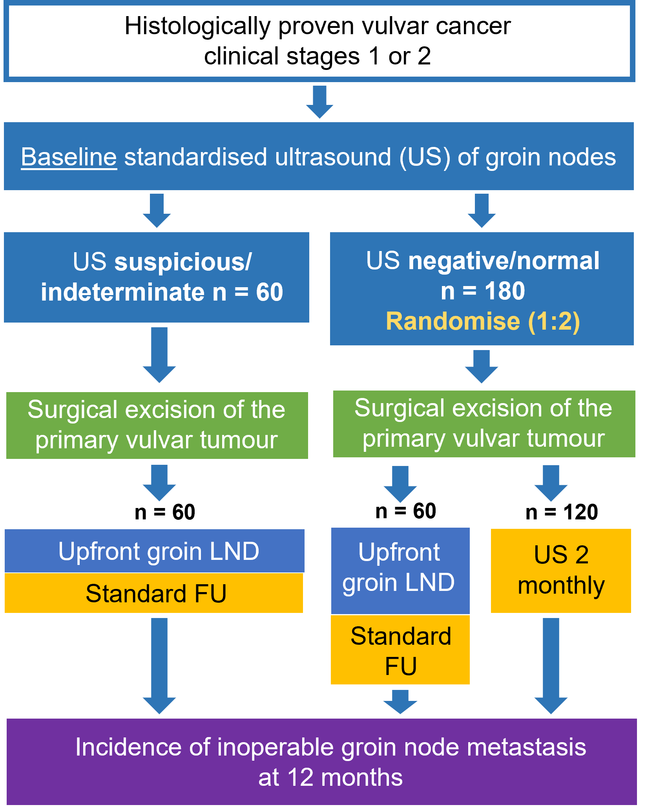
TRIAL SCHEMA
Patients with a normal/negative baseline groin node ultrasound will be randomised 2:1 to receive radical wide local excision or radical vulvectomy with either:
Bilateral groin US q2 months (no groin LND) plus clinical examinations q3 months for a period of 12 months (N=120 Participant)
If the appearance of groin nodes changes and they become suspicious, they will have a groin LND.
OR
Upfront groin LND (sentinel node biopsy (SNB) or an inguinofemoral lymph node dissection (IFL)) (N=60 Participant)
Participants with suspicious/indeterminate groin node ultrasound will not be randomised but receive standard care. Estimate N=60 Participant.

Slide 10
STRATIFICATION CRITERIA FOR RANDOMISATION
Depth of invasion
1-2 mm vs 2.1-3 mm vs 3.1+ mm
Depth of invasion may be defined according to either FIGO 2018 or 2021.
HPV status
HPV positive
HPV negative
Histological cell type
SCC
All other cell types (i.e. adenocarcinoma, melanoma)
Charlson Comorbidity Index (<5, ≥5)

Slide 11
STUDY INTERVENTION
Eligible women (n=240) will receive a bilateral groin node ultrasound up to 30 days prior to planned surgery.
If Suspicious/Indeterminate:
Upfront full groin LND or SNB (standard treatment based on local guidelines; estimated n=60).
If Negative/Normal (n=180):
Randomised 2:1:
Groin LND (n=60)
Bilateral groin USM every 2 months and clinical examination every 3 months for 12 months (n=120; no upfront groin LND).
All participants will receive appropriate surgical excision of the primary tumour (radical wide local excision or radical vulvectomy). All lymph nodes will undergo central pathology review. Postoperative treatment will follow local institutional treatment guidelines.

Slide 12
TRANSLATIONAL RESEARCH
All participants (pending consent) will be asked to donate blood samples and Formalin-Fixed Paraffin Embedded (FFPE) tissue for future molecular and biomarker research.
Collection Process:
Clinical trial coordinators will arrange for samples to be sent to a central laboratory in Queensland for histopathology review.
Blood Sample collection (Australian sites only):
For Standard Upfront Groin LND:
Blood collected at baseline (prior to surgery) and 8 weeks post-surgery.
For Serial High-Resolution Groin USM:
Blood collected at baseline and during each of the seven ultrasound visits.

Slide 13
SURGICAL AND PATHOLOGY PROTOCOL FOR STUDY PARTICIPANTS
Primary Tumour Excision:
All participants will receive appropriate surgical excision of the primary vulvar tumour.
Groin Lymph Node Dissection (LND) = standard treatment group:
Options: Full inguinal-femoral lymphadenectomy (IFL) or sentinel node biopsy (SNB).
Procedure based on institutional guidelines, can be unilateral or bilateral.
Eligibility for SNB:
Tumours less than 4 cm in largest diameter, unifocal.
Tracer agent for SNB is not specified.
Sentinel Node Pathology:
Ultra-staging:
Sentinel nodes will undergo ultra-staging (sites will follow their own protocol)
Minimum requirement: Immunohistochemistry for cytokeratin on each block of sentinel lymph node tissue.
Notes:
All participants will receive appropriate surgical excision of the primary vulvar tumour (radical wide local excision or radical vulvectomy).
For participants who receive standard groin LND, patients can have either a full IFL or a SNB (tracer agent not specified) as per institutional guidelines, unilaterally or bilaterally as appropriate. Patients for SNB need to have tumours less than 4 cm in largest diameter and must be unifocal. Sentinel nodes will undergo ultra-staging [1]. Each pathology laboratory will follow its own protocol for ultra-staging, but at a minimum this should include immunohistochemistry for a cytokeratin on each block of sentinel lymph node tissue.

Slide 14
CRITERIA FOR GROIN NODE EVALUATION
Ten criteria to be captured on a trial-specific case report form for each identified groin node:
Shape (globular vs non-globular)
Homogeneity of echo structure
Hyper- or hypoechoic areas within the lymph nodes
Hilum abnormalities
Cortical thickening
Nodal grouping
Long (L) and short (S) axis (L/S ratio; values of <2 are considered abnormal) for the most suspicious or largest lymph node
Perinodal hyperechoic ring (inflammation)
Cortical interruption (possible extra-nodal spread)
Nodal vascularity

Slide 15
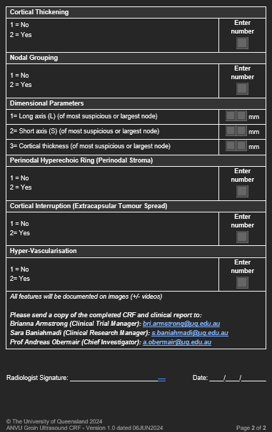
US CASE REPORT FORM

Slide 16
POSTOPERATIVE ADJUVANT TREATMENT
No Adjuvant Radiation Needed:
Patients with a full IFLND and one positive node without extracapsular spread.
After Bilateral IFLND:
Patients with 2 or more positive nodes; any extracapsular spread.
Patients with a positive sentinel node 2 mm or less in diameter.
After SNB:
Patients with a positive sentinel node <2mm: bilateral groin and pelvic radiation treatment
Patients with a positive sentinel node >2mm: Full IFLND + adjuvant radiation.
Follow Institutional Guidelines

Slide 17
MANAGEMENT OF SONOGRAPHICALLY SUSPICIOUS NODES
ULTRASOUND MONITORING GROUP: If suspicious/indeterminate sonographic changes, participants will be referred urgently for clinical management
Options for management include:
FNA/core biopsy +/- continuation with bilateral groin US q2 and clinical examinations q3 months
Remaining on trial
Standard groin lymphadenectomy (LND)
Postoperative Management:
Participants undergoing LND (cross overs) will no longer require groin ultrasound, blood collections or clinical examinations.
Remain on trial
Data Collection: Data will continue to be collected up to the original 12-month point
Patients that fail to comply with the serial ultrasound will be removed from the trial
and referred back to their gynaecological oncologist for alternative treatment for safety reasons

Slide 18
STOPPING RULES
Patients with enlarged, palpable groin nodes have a >90% mortality within 12 months.
Incidence of groin node failure within 12-month of an upfront LND, is ~3% in usual practice.
False negative rate for SNB* (Tc + blue dye) was 6.6% [4.9% to 9.0%] (Covens et al. Gyn Oncol 2015)
Groin node recurrence rate after complete IFLND was 1.4%, selected IFLND (6.6%), SNB (3.4%).
A recurrence probability of 6% would be acceptable.
Stopping early due to unacceptably safety will be triggered if recurrence rate is > 5/40, 6/60, 7/80, 9/100, or 10/120 patients.
The statistical design accommodates expansion beyond N=120 ultrasound participants (e.g., as a protocol amendment) if neither safety criterion is reached and the predicted probability of success given expansion is at least 80%.
*SNB followed by complete IFLND

Slide 19
TRIAL GOVERNANCE
The trial will continuously monitor the number of enlarged, palpable groin node metastases/recurrences across all groups (see stopping rules) with stopping rules in place if these exceed the upper limit of normal.
Quality Assurance : A central histopathology review will categorise involved nodes into positive, micro-metastasis, or isolated tumour cells.
Trial Management Committee (TMC): The TMC, comprising the Chief Investigator (CI), clinicians, and specialists, will supervise the trial's execution, meeting 2-3 times a year to ensure compliance with standards and recommend protocol modifications based on data reviews.
Independent Data Safety Monitoring Committee (IDSMC): The IDSMC will monitor patient safety, data completeness, and efficacy, providing independent advice on trial conduct; they will meet regularly to review safety analyses and report findings to the TMC, with the authority to recommend early trial closure if safety concerns arise.
Recurrence Adjudication Committee (RAC): The RAC will independently review documented recurrences every six months from year two onward, ensuring unbiased assessments based on expertise in gynaecological oncology, thus guaranteeing accuracy and consistency in reported events.
Missing Ultrasound or Physical Examination: In the event a participant misses an ultrasound or examination by ±7 days, the trial PI will be notified, and prompt rescheduling will occur with dedicated staff ensuring adherence to monitoring schedules and timely communication of any issues.

Slide 20
STUDY SCHEDULE

Slide 21
STUDY SCHEDULE

Slide 22
Feasibility
Pre-ANVU
ANVU
Feasibility Study
Sample size: 50
Start date: Aug 2022
Recruitment #: 20
Per patient payment
Phase II
Sample size: 240
Aus Sites: 13 sites
Int sites: 2+
Start date: June 2025
Payment schedule:
Set up $2,000
Per patient: $1,500
+ Ultrasound reimbursement
AUS (13): QLD (5), RHW (VIC),
Mercy (VIC), Northshore (NSW),
Newcastle (NSW), RDH (NT),
RAH (SA), RHH (TAS), SJOG (WA).
INT’L (2): UZ Leuven (BEL),
Casmu (URUG)

Slide 23
STUDY TEAM CONTACT DETAILS
Sara Baniahmadi
Clinical Research Manager
E: s.baniahmadi@uq.edu.au
E: sara.baniahmadi@health.qld.gov.au
Brianna Armstrong
Clinical Trial Manager
E: bri.armstrong@uq.edu.au
E: brianna.armstrong@health.qld.gov.au
General Study Email: anvutrial@uq.edu.au

Slide 24
NEXT STEPS…

