Slide 1
What type of complementary therapies are gynaecological cancer patients using and what are the perceived benefits
Professor Monika Janda
Centre for Health Services Research
The University of Queensland

Slide 2
Definitions
Complementary therapies
Used along with the traditional medicine treatment
Can be diets, exercise, yoga
Plant-based medicines, supplements, vitamins
Traditional Chinese medicines
Relaxation, deep breathing
Prayers
Alternative Medicines
Used instead of traditional medicine treatment
Luckily uncommon in Australia
Some prominent cases in the media
Johnson SB, Park HS, Gross CP, et al.: Use of Alternative Medicine for Cancer and Its Impact on Survival.
J Natl Cancer Inst 110 (1): , 2018

Slide 3
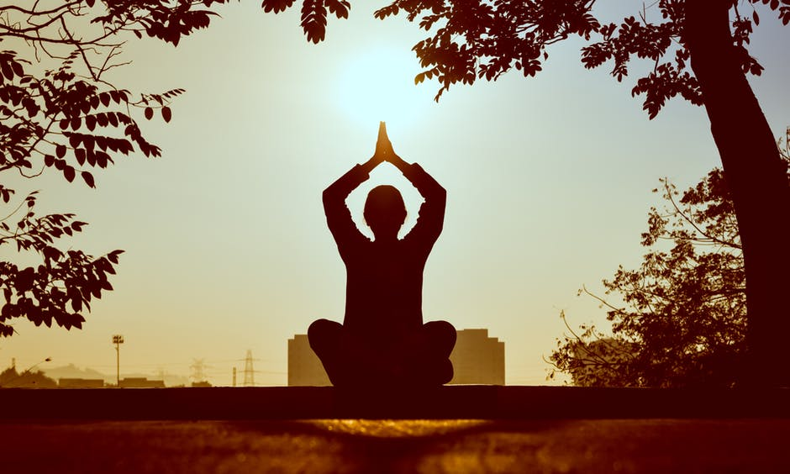
New term: integrative therapies
Integrative therapy is medical care that combines standard care with complementary practice, examples:
Olivia Newton-John Cancer Wellness & Research Centre – offers Music Therapy, Oncology Massage and Gentle Yoga
Bloomhill Cancer Care – Centre for excellence in integrated cancer care offers Counselling, Oncology massage, Reflexology, Meditation and Art therapy

Slide 4
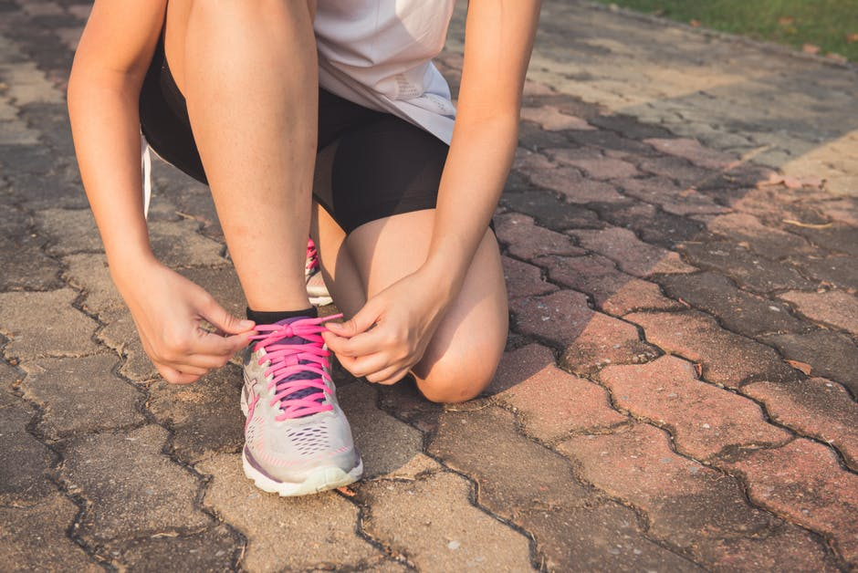
How common are complementary medicines used?
Estimates depend on a number of factors:
Region of the world
What is included in the definition of complementary (e.g. are vitamins or prayer included or not)
Mind-body practices/Natural Products/Other e.g. Acupuncture
The population under study – e.g. population overall, or people who have had cancer

Slide 5
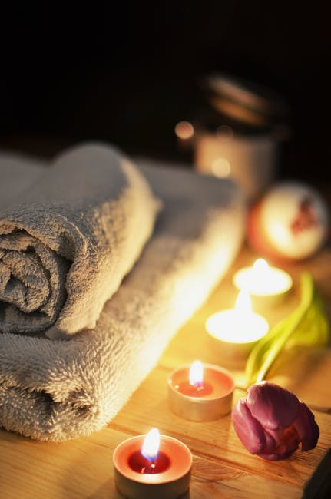
Some estimates from the World Health organisation
80% of people in developing nations rely on complementary medicines – they do not have access to surgery, chemotherapy or radiotherapy
In Western countries up to 38% of people use complementary medicines
Up to 69% of cancer patients use complementary medicines
Very few use alternative medicine refusing western traditional medicine <1%

Slide 6
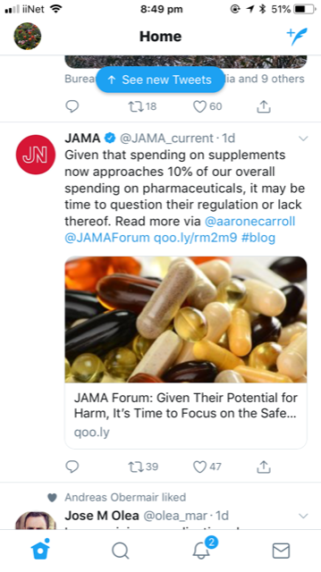
Vitamins and supplements
US consumers spend about $30 billion on supplements, including vitamins, minerals, and herbal products.
About a third of children and adolescents in the US use dietary supplements.
Use of supplements in people older than 70 years increased from 52% to 64% between 2005-2011.

Slide 7
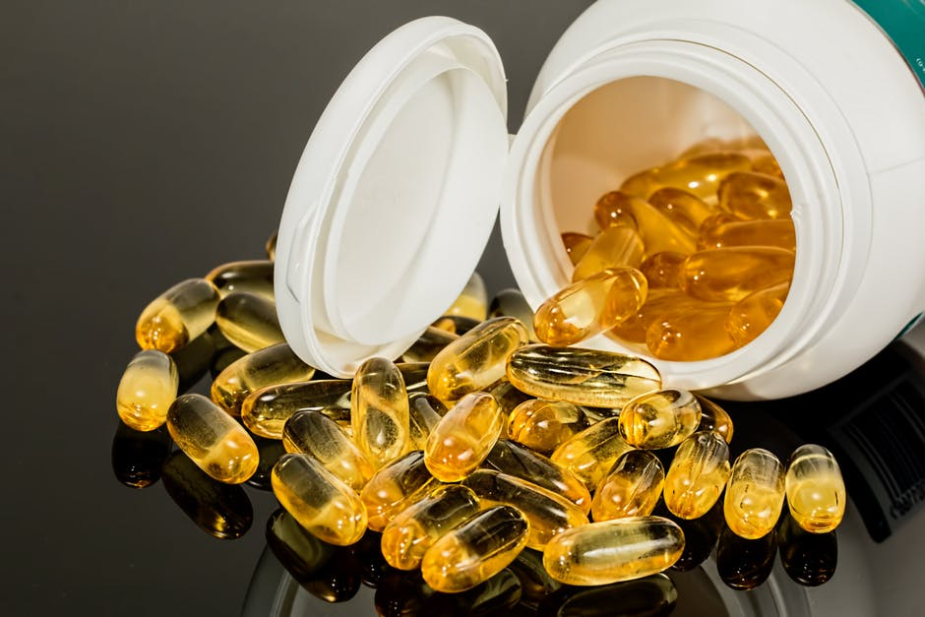
Australian Data
Among over-the-counter products sold in pharmacies that did not require a prescription, natural health products were the largest selling items in 2015–16 ($1.4 billion) (AIHW).
It is estimated that more than two-thirds of the Australian population use Complementary Medicines
Nationally, the annual ‘out of pocket’ expenditure on Complementary Medicines is estimated to be approximately $4 billion (NHMRC).

Slide 8
How about cancer patients in Australia?
Estimates based on survey data
Horneber, et al. Integrative Cancer Therapies 2012;
11(3) 187–203

Slide 9
Pharmacodynamics and pharmacokinetics
Drug-drug interactions
Overlap of pharmacological actions
Changes or overload in absorption, distribution, metabolism or excretion.
Classic examples: St John's wort – increases metabolism of many drugs and therefore lowers the concentration of the concomitant drug.
Ginkgo can increase the bleeding risk when given with warfarin.

Slide 10
Long term follow-up of QCGC LACE study
Participants: Women about 10 years after cancer surgery
Patient characteristics
1. Age at surgery (average) | 58 years
2. Weight at surgery (average) | 91.5 kg
3. Weight at interview (average) | 87.9 kg
Normal (18.50-24.99) | 12.5 %
Overweight (25.00-29.99) | 25.0 %
Obesity class I (30.00-34.99) | 12.5 %
Obesity class II (35.00-39.99) | 25.0 %
4. Type of surgery received
Abdominal Hysterectomy | 47.1 %
Laparoscopic Hysterectomy | 52.9 %

Slide 11
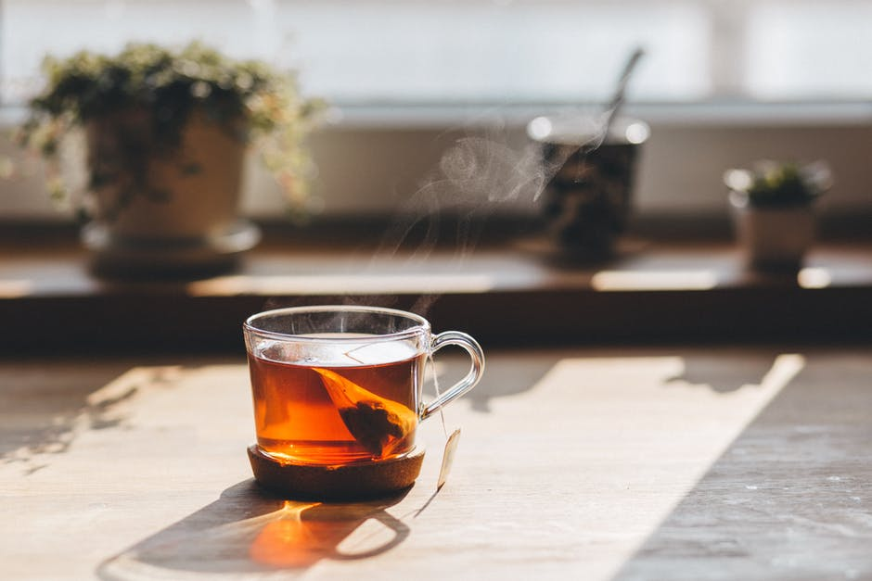
Most commonly used
Meditation
Reiki
Natural herbs/remedies (e.g. vinegar, magnesium, herb mixes, olive leaf extract, Rosehip)
Vitamins and Fish Oils
Green tea
Green smoothies
Probiotics

Slide 12
Example quotes
“I have a library full of books on health and what you should eat, what you shouldn't eat”
Reiki “allowing your body to receive healing and all that sort of thing as well”
“That would help, visualise their body healed and well, and that sort of thing”
“wonderful lifestyle. The air was clear, we ate well”
“tried to do as much as possible, increase the walking and cycling and now taking up the Qi Gong in addition”
“Vitamins, Fish Oil”
“I read a lot of material about natural medicine, to try and use things like vinegar - apple cider vinegar, magnesium, all those sorts of things like that. To help me through things”

Slide 13
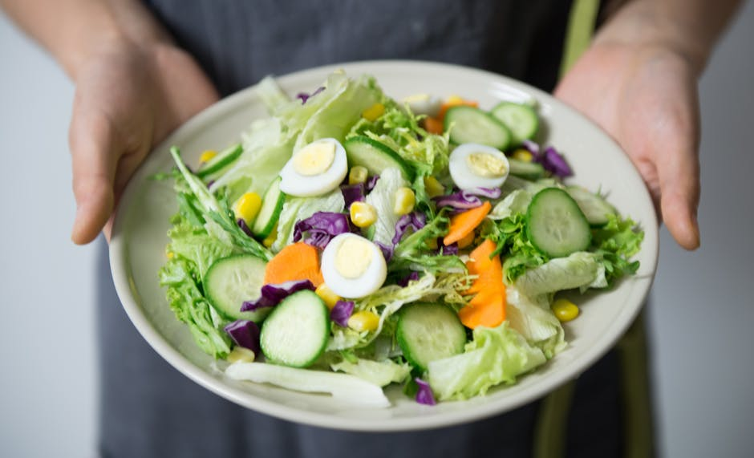
Healthy diet, exercise, healthy mind
Try to stay healthy
Avoid sugar (I quit sugar campaign)
Avoid chemicals
Foods that one disagrees with
Exercise daily
Pilates

Slide 14
Why do people use complementary medicines
To reduce the side effects of cancer treatment chemo/radio-therapy
Slow the progression of cancer
Improve quality of life
Cope with anxiety/depression
Being in control
Maximize the success of treatment through their own actions
Li et al. Cancer 2018;124:1207-15.

Slide 15
Weighing up the benefits and risks
Drug metabolic interactions (e.g. St Johns Worth and imatinib)
Treatment interactions (e.g. antioxidants and radiotherapy)
Organ toxicity (e.g. green tea and liver toxicity)
Cancer growth (e.g. phytoestrogens)

Slide 16
Checking for interactions
Natural Standard www.naturalstandard.com
Natural Medicines Comprehensive Database www.naturaldatabase.com .

Slide 17
Open Conversation very important
Doctors/Nurses often don’t ask
Patients don’t tell
Need more active conversations to increase benefit and reduce harm

Slide 18
NHMRC recommends
Clinicians could initiate the discussion by asking their patients if:
they have tried anything else to help with their problem
they have used any herbal or natural remedies, Bush Medicine or traditional medicines or treatments, vitamins or supplements that they have bought from a supermarket, chemist or health food store, or that they have grown or prepared themselves
they have seen a CM practitioner
they have tried changing their diet because they thought it might help
their problem, for example by adding or eliminating particular foods or food groups.

Slide 19
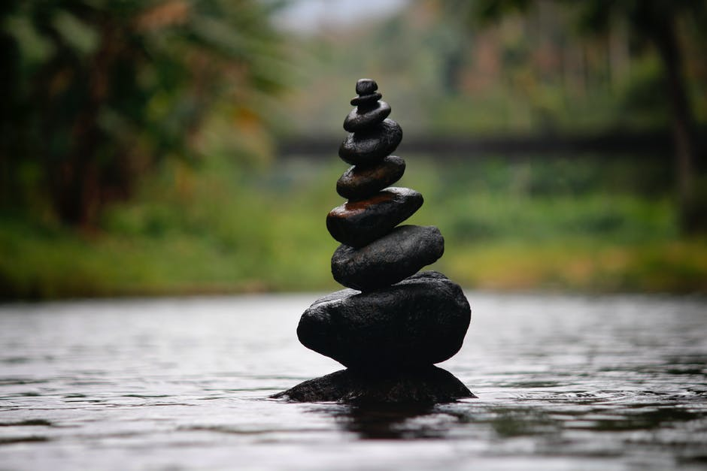
In summary
Complementary medicines very commonly used by cancer patients
Help feel in control, actively doing something
Evidence lacking for many substances
Potential for harmful interaction with traditional medicines
Important to talk

